Slide 1
Welcome to CS10 Group Fourth Meeting
Team member
Wilma Liu (Leader)
Fiona Hu
Pat Zhang
Elvia Tong
Reehaa Ding
William Quan

Slide 2
This week meeting schedule
Works have been done since last week
Report the issues from the meeting with the course instructor
Proposal for the future work

Slide 3
Highly Impacted Industries
Works have been done since last week
Report the issues from the meeting with the course instructor
Proposal for the future work

Slide 4
This week meeting schedule
Works have been done since last week
Report the issues from the meeting with the course instructor
Proposal for the future work

Slide 5










Project Objective & Aim
Analysing the most impacted areas by COVID-19
Travelling, Customer Service and Economy
Forecast the problem impact in the future
Researching the support and relevant policies
Combine the problem impact forecast with the possible supports
Provide recommendations in qualitative way for these areas when similar pandemic or disaster occur
Problem identification
Problem Data Analysis
(Machine learning)
Support recommendation
Problem Data Collection
Support identification

Slide 6
Project Objective & Aim
Analysing the most impacted areas by COVID-19
Travelling, Customer Service and Economy
Forecast the problem impact in the future
Researching the support and relevant policies
Combine the problem impact forecast with the possible supports
Provide recommendations in qualitative way for these areas when similar pandemic or disaster occur
Problem identification
Problem Data Analysis
(Machine learning)
Support recommendation
Problem Data Collection
Support identification

Slide 7
Project Objective & Aim
Analysing the most impacted areas by COVID-19
Travelling, Customer Service and Economy
Forecast the problem impact in the future
Researching the support and relevant policies
Combine the problem impact forecast with the possible supports
Provide recommendations in qualitative way for these areas when similar pandemic or disaster occur
Problem identification
Problem Data Analysis
(Machine learning)
Support recommendation
Problem Data Collection
Support identification

Slide 8
Project Objective & Aim
Analysing the most impacted areas by COVID-19
Travelling, Customer Service and Economy
Forecast the problem impact in the future
Researching the support and relevant policies
Combine the problem impact forecast with the possible supports
Provide recommendations in qualitative way for these areas when similar pandemic or disaster occur
Problem identification
Problem Data Analysis
(Machine learning)
Support recommendation
Problem Data Collection
Support identification

Slide 9
Last week we are here
Problem identification
Problem Data Analysis
(Machine learning)
Support recommendation
Problem Data Collection
Support identification

Slide 10
Problem Impact Scope
Impact of the COVID-19 to different departments
Travelling
Grocery/Recreation visits
Economy
Personal insolvency
Business close

Slide 11
Last week- Problem Identification+ Data Collection- Business close
Problem identification
Problem Data Analysis
(Machine learning)
Support recommendation
Problem Data Collection
Support identification

Slide 12
Problem Data Analysis with support- Business close
Problem identification
Problem Data Analysis
(Machine learning)
Support recommendation
Problem Data Collection
Support identification

Slide 13
Problem Data Analysis with support- Business close
1. Measuring the effectiveness of the support using Neural Network Model
2. Measuring the effectiveness of the support using Interactive Visualizations
Problem identification
Problem Data Analysis
(Machine learning)
Support recommendation
Problem Data Collection
Support identification

Slide 14
1. Measuring the effectiveness of the support-Neural Network Model
1.1 Extract time range and support eligibility metrics from specific government supports
• Time range
• Support eligibility metrics - Turnover range by specific time
• Support eligibility metrics- Highly impact industries

Slide 15
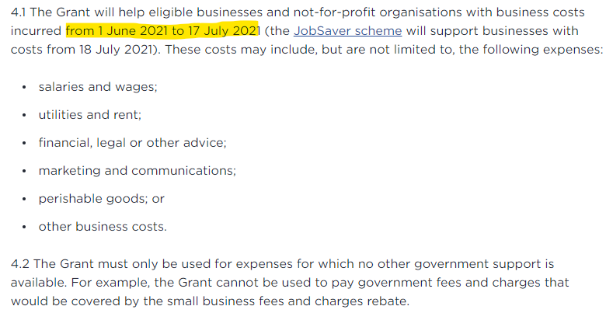
1. Measuring the effectiveness of the support-Neural Network Model
1.1 Extract time range and support eligibility metrics from specific government supports
• Time range:
Referring to the ‘how funding may be used’ section
The specific time range of the grant implemented (support impact)

Slide 16
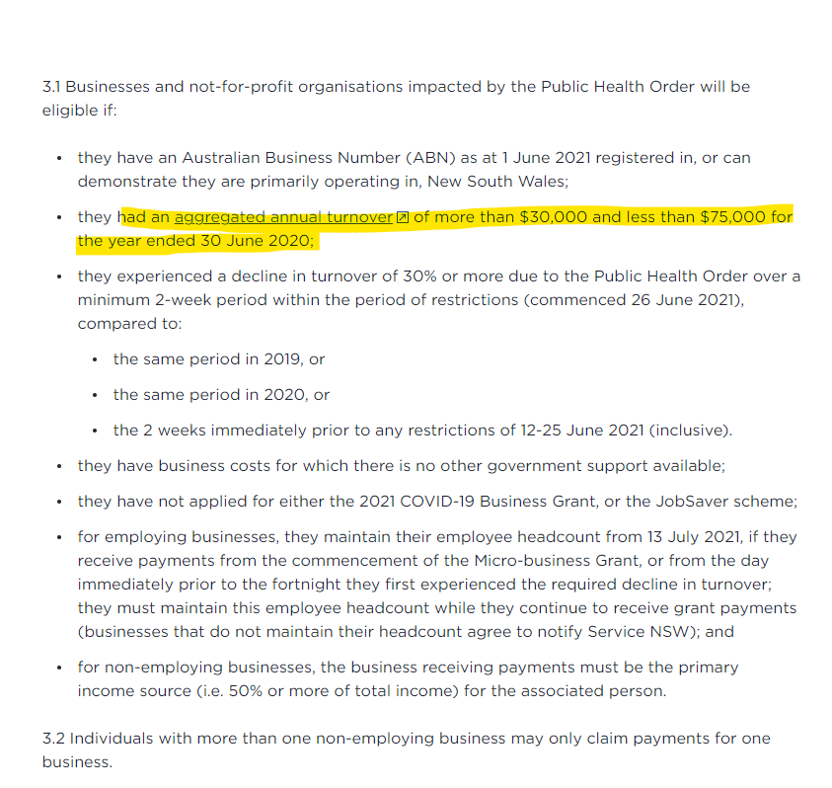
1. Measuring the effectiveness of the support-Neural Network Model
1.1 Extract time range and support eligibility metrics from specific government supports
• Support eligibility metrics - Turnover range by specific time
Referring to the ‘eligibility criteria’ section

Slide 17
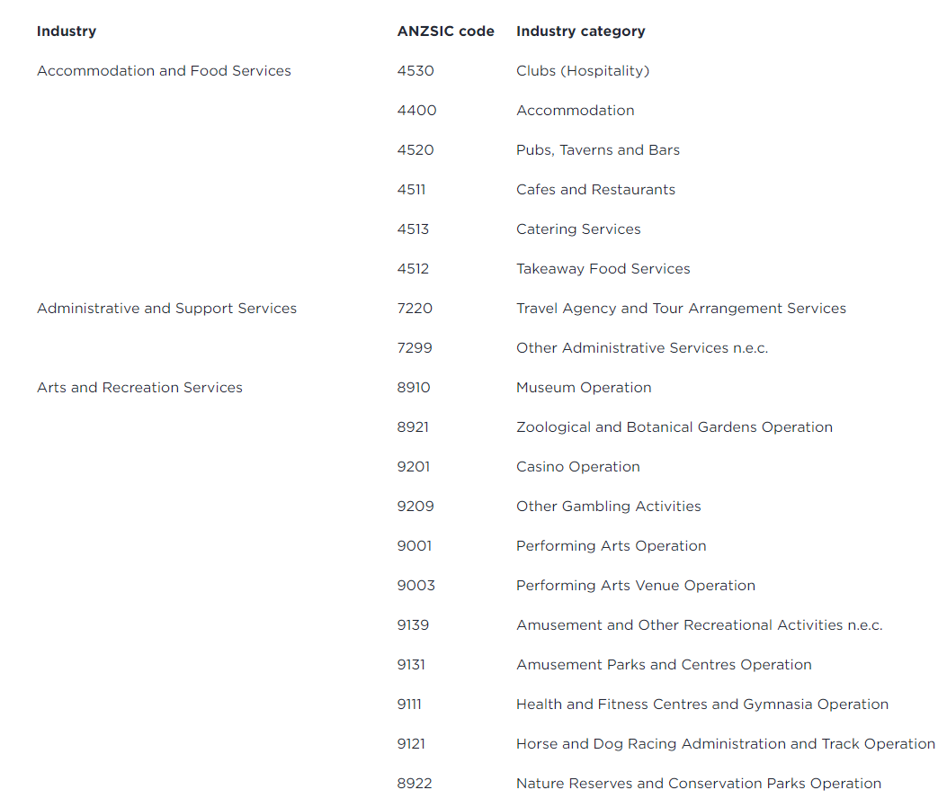
1. Measuring the effectiveness of the support-Neural Network Model
1.1 Extract time range and support eligibility metrics from specific government supports
• Support eligibility metrics- Highly impact industries
Referring to ‘Attachment B: Highly impacted industries’

Slide 18
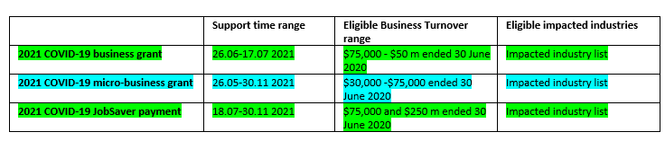
1. Measuring the effectiveness of the support-Neural Network Model
1.2 Extract the support impact data from the business survival data
• Time range
• Support eligibility metrics - Turnover range by specific time
• Support eligibility metrics- Highly impact industries

Slide 19
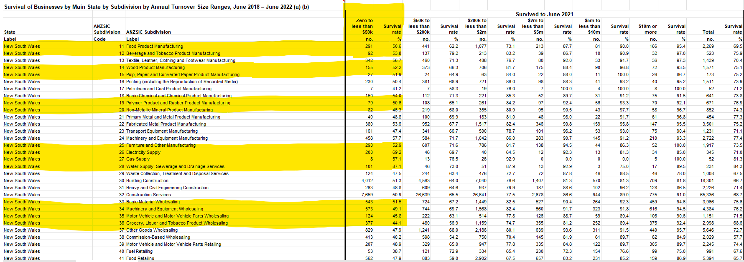
1. Measuring the effectiveness of the support-Neural Network Model
Narrow down to the support impact data

Slide 20
1. Measuring the effectiveness of the support-Neural Network Model
1.3 Build a neural network forecast model to show the comparison before/ after support.
Data used to train the model:
Survival rate of different businesses by turnover Size ranges across sub-industries from 2018-2022
Data input:
2022 Survival rate of different businesses with specific turnover ranges (Zero to less than $50k, $50k to less than $200k…---6 turnover ranges) across sub-industry (Agriculture, Aquaculture…- 99 sub-industries)

Slide 21
1. Measuring the effectiveness of the support-Neural Network Model
1.3 Build a neural network forecast model to show the comparison before/ after support.
Data output
2023 Survival rate of different businesses with the same turnover ranges (6 ranges) across sub-industry (99 sub-industries) as the input data.
Use data output for comparison:
2022 Survival data (prediction) vs 2022 Survival data (actual)
Survival rate
Turnover size

Slide 22
1. Measuring the effectiveness of the support-Neural Network Model
Compare the real support impact data with the prediction data

Slide 23
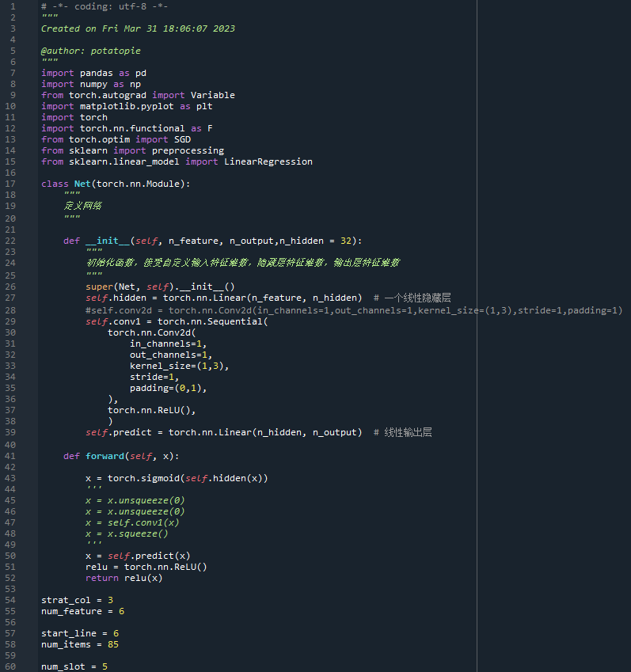
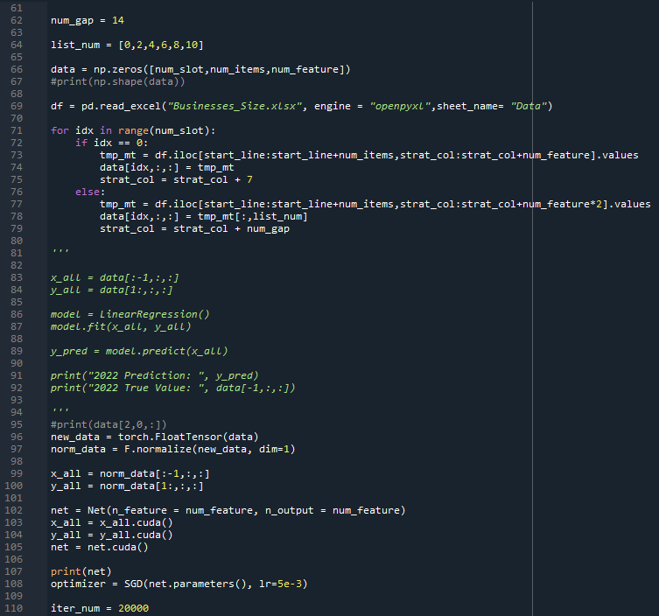
1. Measuring the effectiveness of the support-Neural Network Model

Slide 24
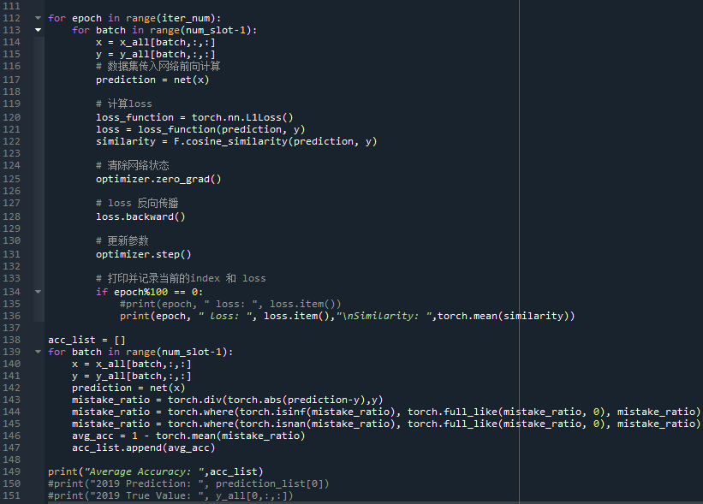
1. Measuring the effectiveness of the support-Neural Network Model

Slide 25
1. Measuring the effectiveness of the support-Neural Network Model
Result
Assess the effectiveness of the specific support
Assess the effectiveness by specific industries

Slide 26

1. Measuring the effectiveness of the support-Neural Network Model
Limitation: Poor prediction performance
Only have 2018-2022 annually data (5 time slots), Time series forecasting need at least 25 time slots (25 years or 25 months)

Slide 27
2. Measuring the effectiveness of the support-Interactive Visualizations
Before/ after support comparison through interactive visualization by industries, show the KPI such as Survival rate and turnover rate.
Limitations:
Better to have the data by monthly
Measure the success of the support from June 2021- Nov 2021
Compare with the 2020 data (also have supports)
Casual effect

Slide 28
Last week: Problem Identification+ Data Collection- Travelling
Problem identification
Problem Data Analysis
(Machine learning)
Support recommendation
Problem Data Collection
Support identification

Slide 29
Problem Data Analysis with support- Travelling
Problem identification
Problem Data Analysis
(Machine learning)
Support recommendation
Problem Data Collection
Support identification

Slide 30
Problem Data Analysis with support- Travelling
Assumption
Changes in tourist numbers
Changes in tourism output (or GDP) & Changes in tourism-related jobs
Evaluation of government policies
Assessing support indicators (increased tourist numbers, consumption, and employment)

Slide 31
Problem Data Analysis with support- Travelling
Possible tourism Indicators (AU):
Tourism consumption (Tables 11, 12, 15, and 17 - International consumption)
Tourism GDP (Table 1)
Tourism exports (Tourism's export value from international visitors spending on
Australian goods and services) (Table 3)
Tourism employment (Tables 18-22)
https://docs.google.com/spreadsheets/d/1rKoMz_CQtYlOk10sDWf-mTTcwzXTC12J/edit?rtpof=true&sd=true#gid=1173093964

Slide 32
Problem Data Analysis with support- Travelling
Possible tourism indicator (NSW):
Extracting the Impact of Tourism on Indicators (GDP, GVA, Consumption, Export, Employment, etc.) in NSW from 2006-2022.
https://www.tra.gov.au/search.aspx?moduleid=11599&multisite=false&keywords=state%20tourism

Slide 33
Problem Data Analysis with support- Travelling
Federal Government Policies for Tourism Recovery:
COVID-19 Consumer Travel Support Program (1st: Dec 2020 - Mar 2021, funding of
$128 million; 2nd: May 2021 - June 2021, total funding of $130 million; 3rd: Mar
2022 - Apr 2022, funding of $75.5 million)
Tourism and Aviation Network Support (over 800,000 half-price airfares)
https://www.austrade.gov.au/australian/tourism/grants-and-support-for-tourism-businesses

Slide 34
Problem Data Analysis with support- Travelling
NSW Government Tourism Recovery Policy:
Oct 2020 - June 2022: Dine & Discover NSW program ($14 million set up, $1 billion boost)

Slide 35
Problem Data Analysis with support- Travelling
Limitations:
Lack of detailed information on individual tourism companies and specific support data, only macro-level annual data, cannot build the machine learning model, may not meet the requirements of our graduation project.
Can only provide information on policy timelines, but lacks specific evaluation data.
Difficult to assess the exact effects of support measures due to time lag and annual calculation of tourism indicators, making it challenging to estimate results using other data.

Slide 36
Problem Data Analysis with support- Travelling
Limitations:
The recovery of the tourism industry is influenced by factors such as national policies, climate change and other confounding factors, making it difficult to establish direct causality from support measures alone. So the interpretation of results may be limited.

Slide 37
This week meeting schedule
Works have been done since last week
Report the issues from the meeting with the course instructor
Proposal for the future work

Slide 38
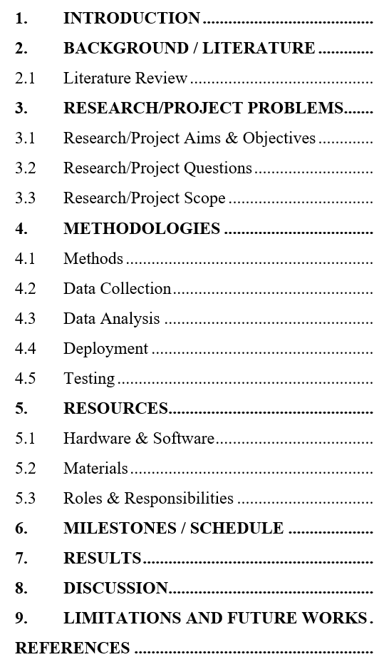
Academic report vs Client delivery
Client delivery
Academic report
Problem impact analysis
List of supports
Measure the effectiveness of supports
Recommendation of future supports

Slide 39
Academic report vs Client delivery
Client delivery
Academic report
Problem impact analysis
List of supports
Measure the effectiveness of supports
Recommendation of future supports

Slide 40
Project Timeline
Group Proposal Report Week 5
Now Week 7
Group Progress Report Week 9
Group Presentation/Seminar – Presentation Week 14
Group Final Report Week 15

Slide 41
Academic report vs Client delivery
Client delivery
Academic report
Machine learning Model
Using data to train, tune and test the model, to ensure the business performance and solve real problem
DA and BA
Match data to the Government Support and COVID-19 Impact, to measure the support success

Slide 42
Academic report vs Client delivery
Client delivery
Academic report
Machine learning Model
Using data to train, tune and test the model, to ensure the business performance and solve real problem
DA and BA
Match data to the Government Support and COVID-19 Impact, to measure the support success
Challenges
Data: Limited time series data (Business Close 2018-2022)
Business: Unconnected to the business and support (Travelling, Insolvency, Grocery, Covid Cases)

Slide 43
This week meeting schedule
Works have been done since last week
Report the issues from the meeting with the course instructor
Proposal for the future work

Slide 44
Academic report vs Client delivery
Client delivery
Academic report
Problem impact analysis
List of supports
Measure the effectiveness of supports
Recommendation of future supports

Slide 45
Academic report vs Client delivery
Client delivery
Academic report
Problem impact analysis
Problem impact forecast
List of supports
Measure the effectiveness of supports
Recommendation of future supports

Slide 46
Add problem impact forecast
Academic report:
Problem impact data available (Travelling, Personal insolvency, and Grocery completed time series data)
Build the forecast model
Client delivery：
Support success measurement (business analysis and data analysis) and recommendation with problem impact forecast (machine learning/ deep learning)
COVID-19 impact forecast is important to know the possible problem impact in the future, helpful to come out new supports.

Slide 47
Thank you !!!

